Slide 1
Discussion 5: Inheritance and Midterm Review
Christine Zhou

Slide 2
Agenda
Announcements
Inheritance Practice
4. Midterm Review on Worksheet
2. Reduce on Worksheet

Slide 3
Announcements
Field hiding is in scope! Same as static lookup
Sorry for the mix-up. We’ll go over this today
Midterm is tomorrow 8-10PM. Room assignments on Piazza
Go to right rooms!
Best of luck!
HW3 is due Friday 11:59PM
Get started on the project!
Discussion survey: tinyurl.com/disc5cz

Slide 4
Inheritance Rules
For non-static methods:
During compilation: If static type has the method, it compiles. Otherwise check parent, parent… Compile time error if no more parent and still haven’t found the method.
During runtime: Run the method in the dynamic type. Otherwise check parent, parent...
For static method:
During compilation: Same as non-static
During runtime: Run the method found during compilation (don’t look at the dynamic type!)
Always look at the dynamic type when running methods, unless the method is static!
For fields:
Use same procedures as static method lookup
Look in the static type for the field and use the field that you eventually find

Slide 5
Field Hiding
If you have a variable of the same name in the static and dynamic type, then this is called “field hiding/shadowing”. It’s possible for the field in the static type to “hide/shadow” the field in the dynamic type.
Field hiding is not good practice!

Slide 6
Example
public class Animal {
public String x = “Animal”;
public static void staticM() {
System.out.println(“A static”);
}
public void nonStaticM() {
System.out.println(“A nonStatic”);
}
public static void m1(Animal a) {
System.out.println(“A m1”);
a.nonStaticM();
}
}
public class Dog extends Animal {
public String x = “Dog”;
public static void staticM() {
System.out.println(“D static”);
}
public void nonStaticM() {
System.out.println(“D nonStatic”);
}
}
public class Runner {
public static void main(String[] args) {
Animal a = new Dog();
System.out.println(a.x);
a.nonStaticM();
a.staticM();
Animal.m1(a);
}
}
Notes:
Animal
D nonStatic
A static
A m1
D nonStatic

Slide 7
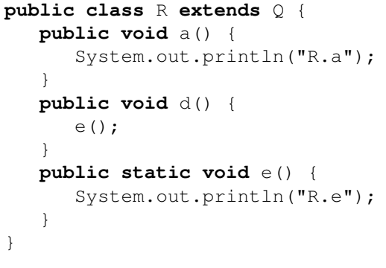
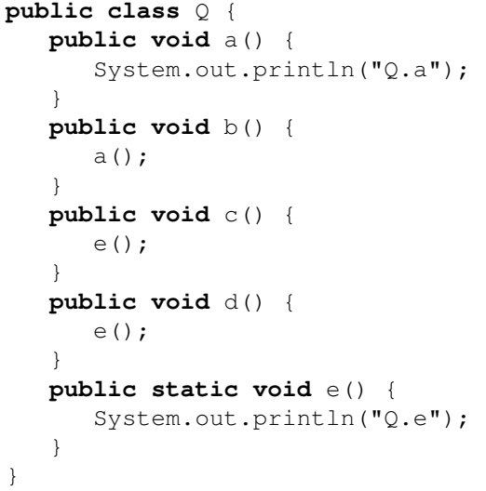
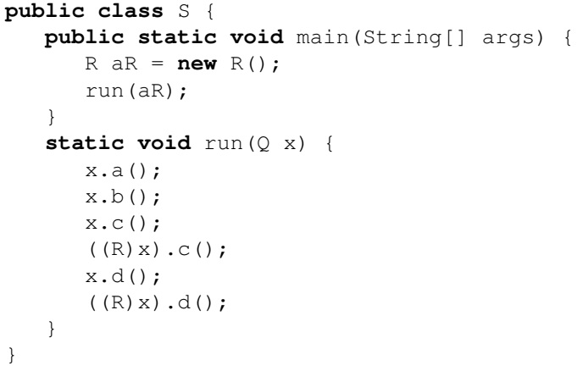

Slide 8
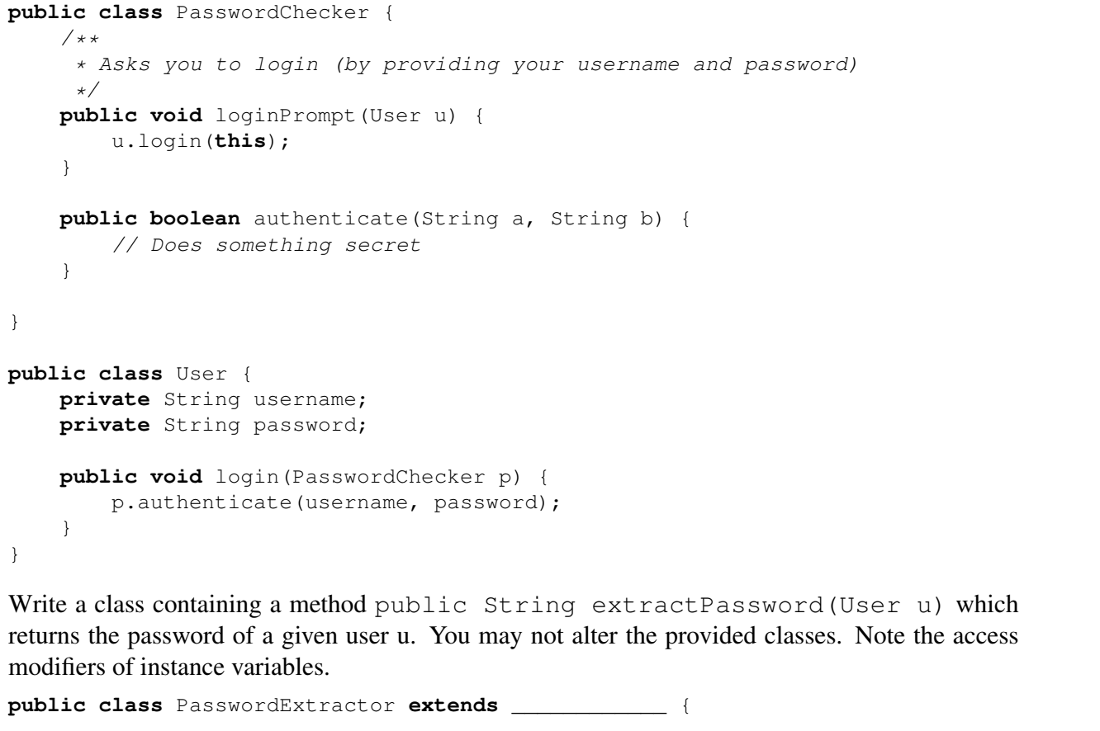
Midterm Review

Slide 9
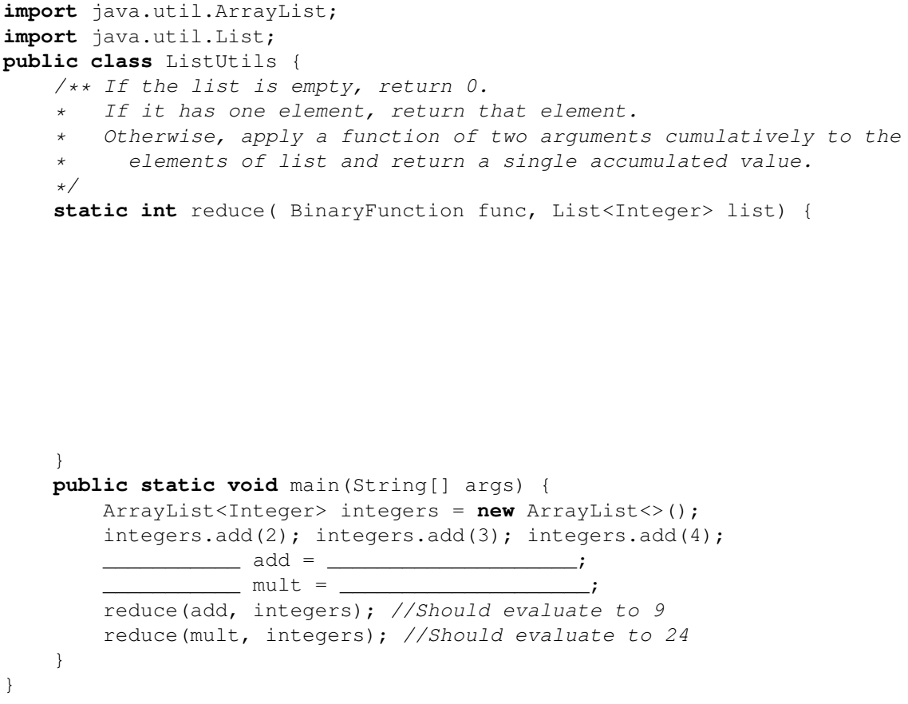
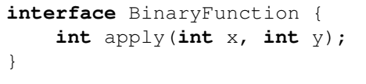
Reduce
Write a method reduce, which uses a BinaryFunction interface to accumulate the values of a List of integers into a single value. BinaryFunction can operate (through the apply method) on two integer arguments and return a single integer. Write two classes Adder and Multiplier that implement BinaryFunction. Then, fill in reduce and main, and define types for add and mult in the space provided.

